Slide 1
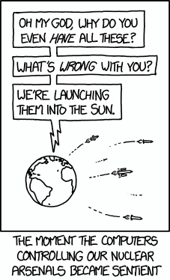

Generative AI:
media (world) generation
Machine Learning Methods for Biomedical Data (D012554)

Slide 2
Autoencoder
An autoencoder is a type of neural network used for unsupervised learning, designed to encode input data into a lower-dimensional representation and then reconstruct it back to its original form.
It consists of two main components: the encoder, which compresses the input into a latent space, and the decoder, which reconstructs the original input from this compressed representation.
Machine Learning Methods for Biomedical Data (D012554)

Slide 3
Autoencoder
The encoder compresses the data from a higher-dimensional space to a lower-dimensional space (also called the latent space)
The decoder does the opposite i.e., convert the latent space back to higher-dimensional space.
latent space (embedding)
encoder
decoder
Machine Learning Methods for Biomedical Data (D012554)

Slide 4
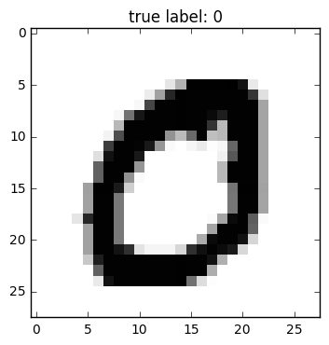
Autoencoder
Machine Learning Methods for Biomedical Data (D012554)

Slide 5
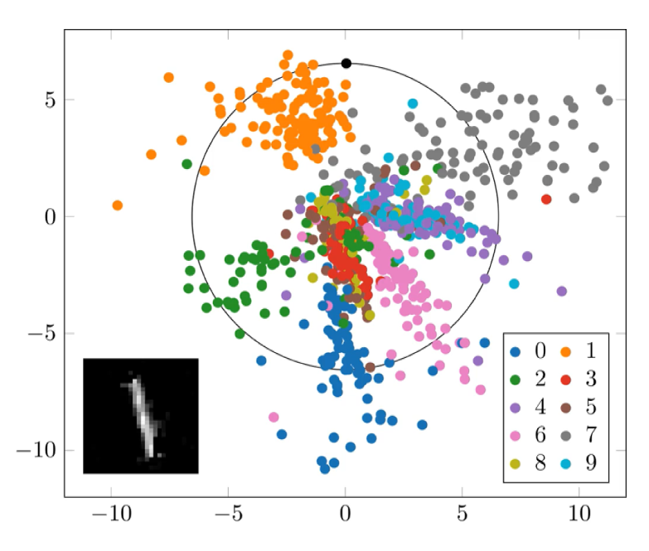
Autoencoder
Machine Learning Methods for Biomedical Data (D012554)

Slide 6
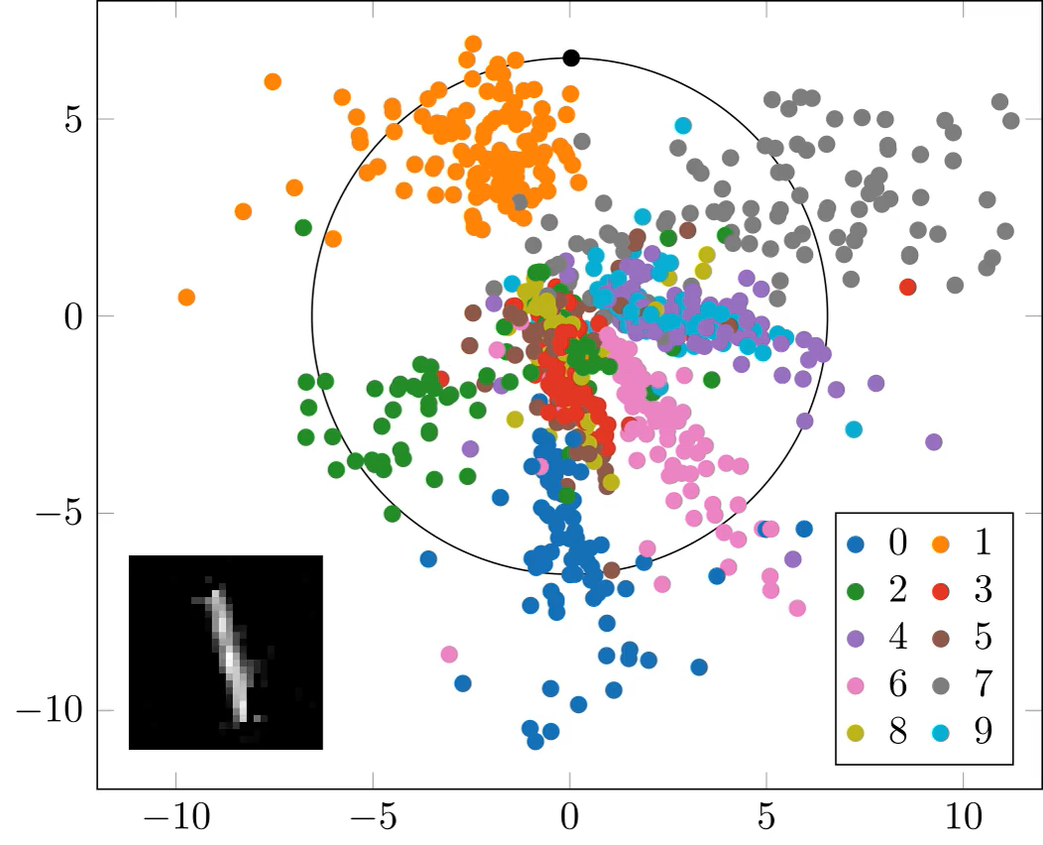
Autoencoder
Machine Learning Methods for Biomedical Data (D012554)

Slide 7
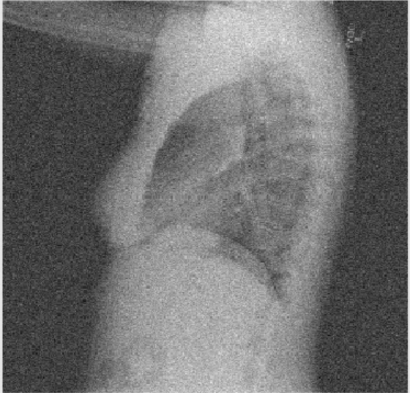
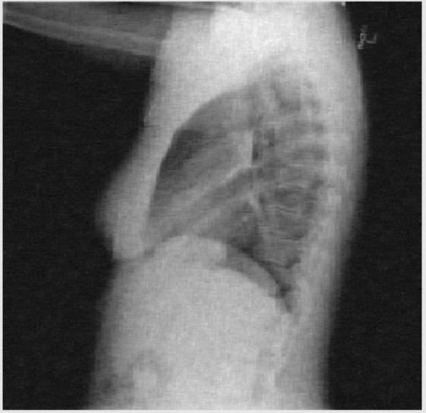
Denoising autoencoder
Autoencoders can easily be trained to denoise image data, expression data, …
The principle is to force the latent space layer capture the most robust features by reconstructing a clean input from a corrupted one.
Machine Learning Methods for Biomedical Data (D012554)

Slide 8
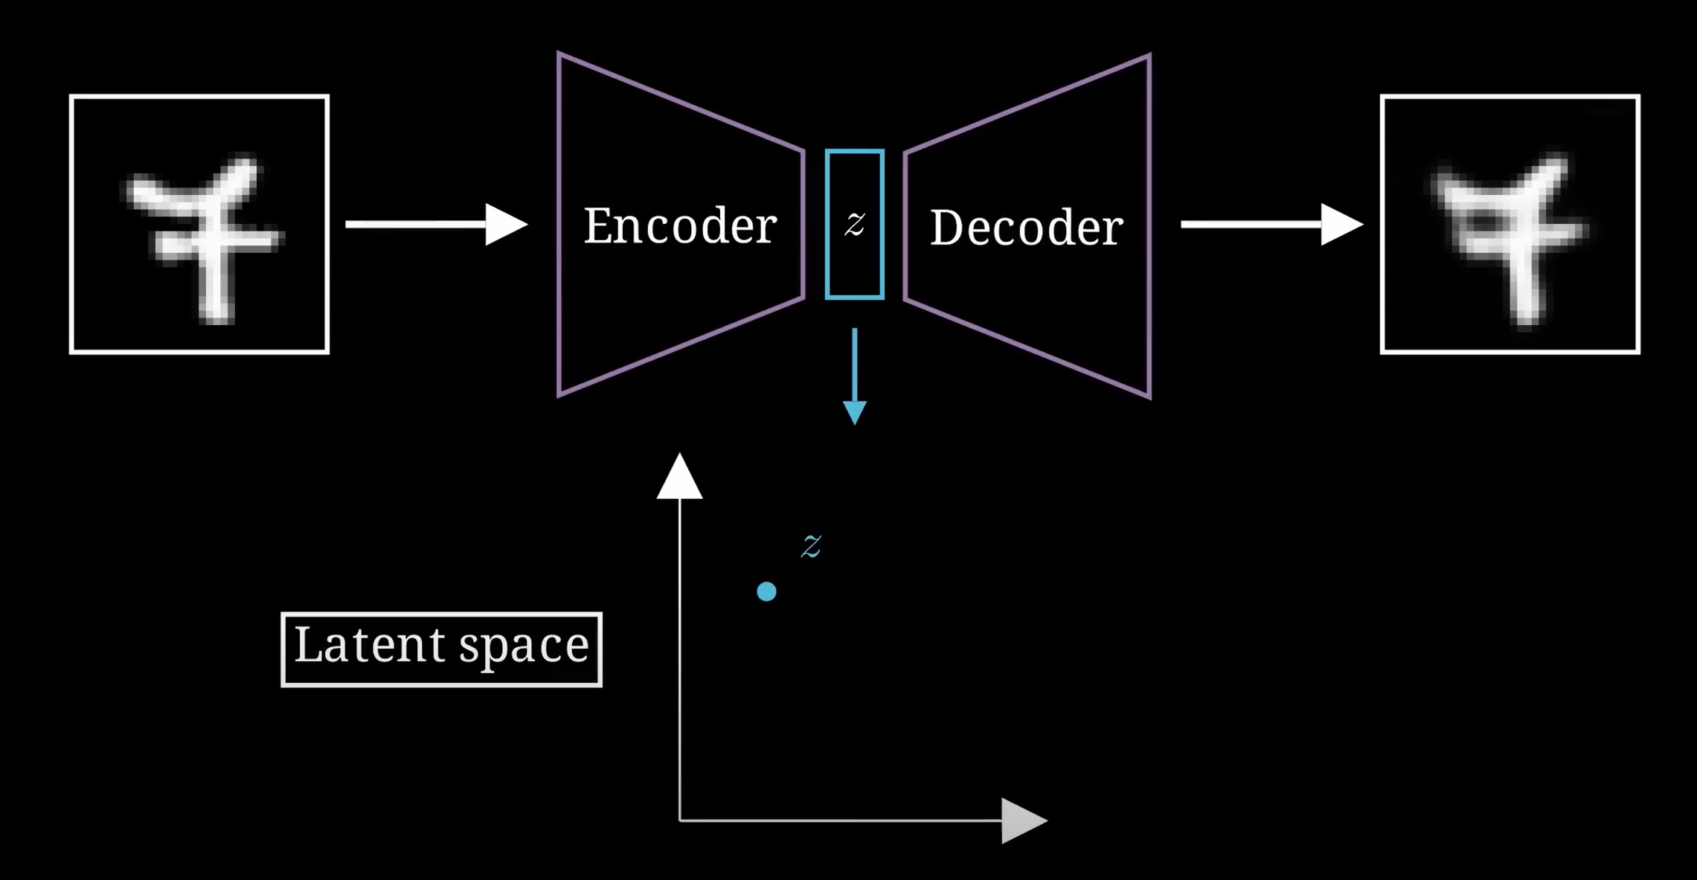

Slide 9
Autoencoder
Sparse and unstructured latent space: Normal autoencoders encode each input into a single fixed point in the latent space without enforcing a continuous distribution.
As a result, interpolating between different points often leads to unrealistic or meaningless outputs.
Since the encoder directly maps inputs to arbitrary points, sampling from the latent space (to generate new data) is unreliable.
There is no guarantee that points between learned encodings correspond to meaningful variations of the data.
Machine Learning Methods for Biomedical Data (D012554)

Slide 10
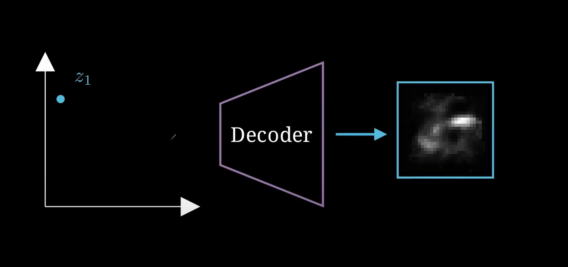

Slide 11
Variational autoencoder (VAE)
Latent space representation: A VAE learns a probabilistic distribution of the input data in a lower-dimensional latent space, rather than mapping inputs to fixed points like traditional autoencoders.
The encoder transforms inputs into a probability distribution (mean & variance) in the latent space, while the decoder reconstructs data by sampling from this distribution.
VAEs use a Kullback-Leibler (KL) divergence loss to ensure that the learned latent distribution remains close to a standard normal distribution, promoting smoothness and continuity in the latent space.
Machine Learning Methods for Biomedical Data (D012554)

Slide 12
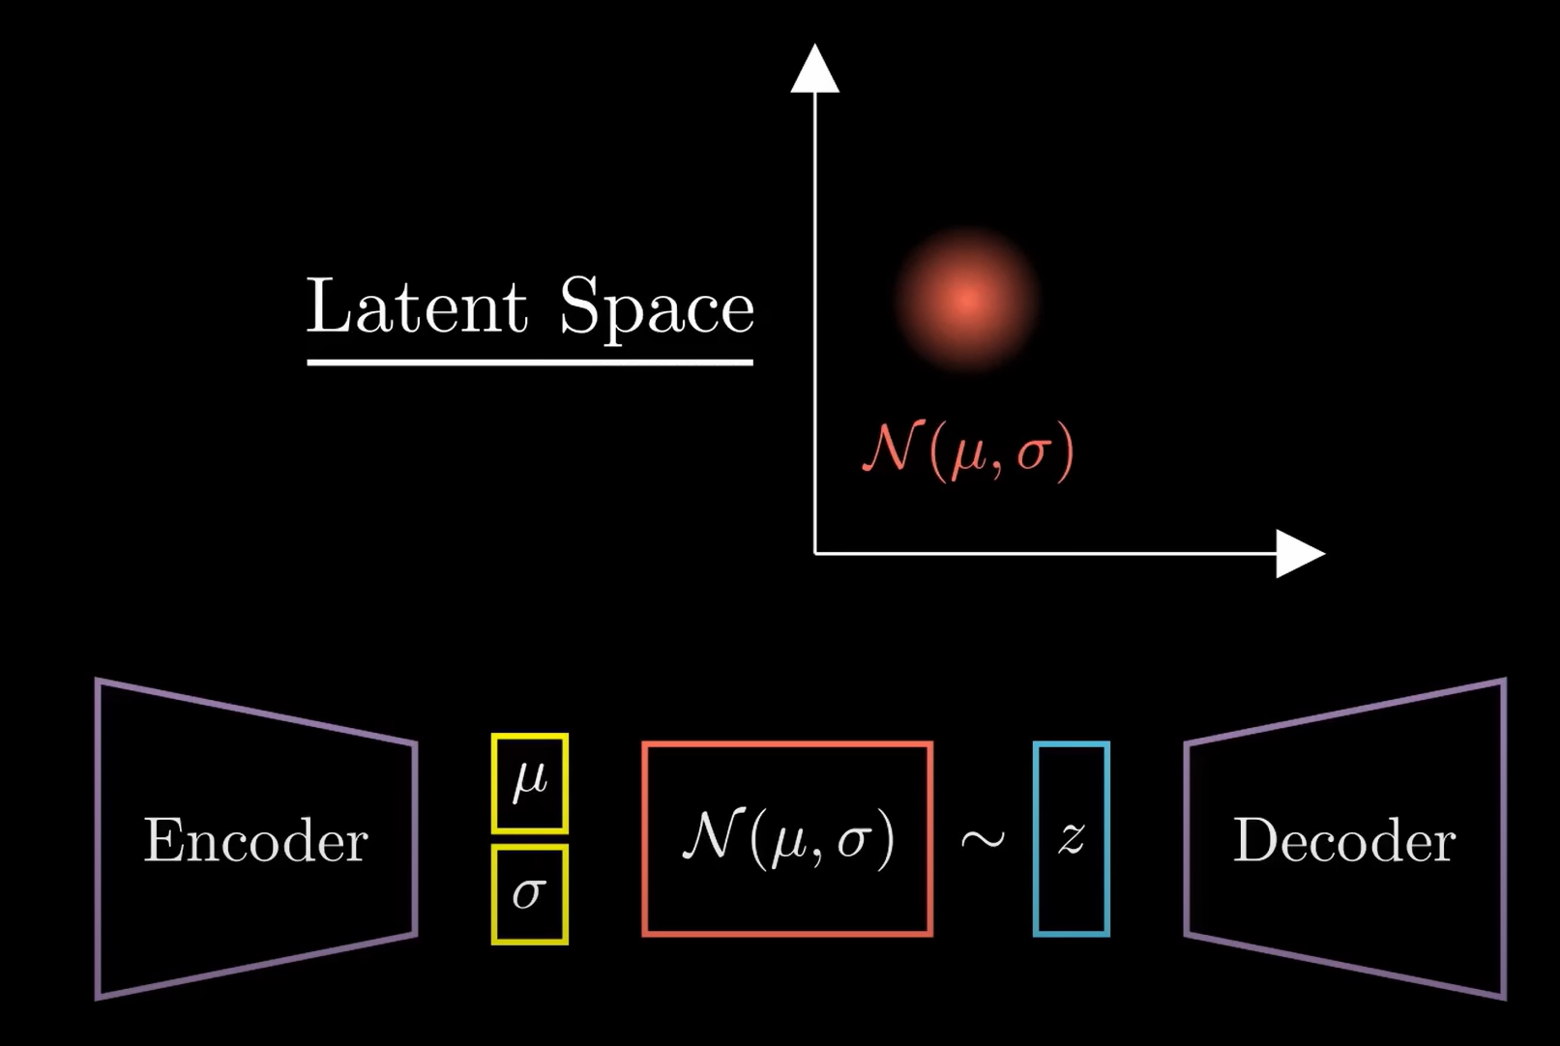

Slide 13
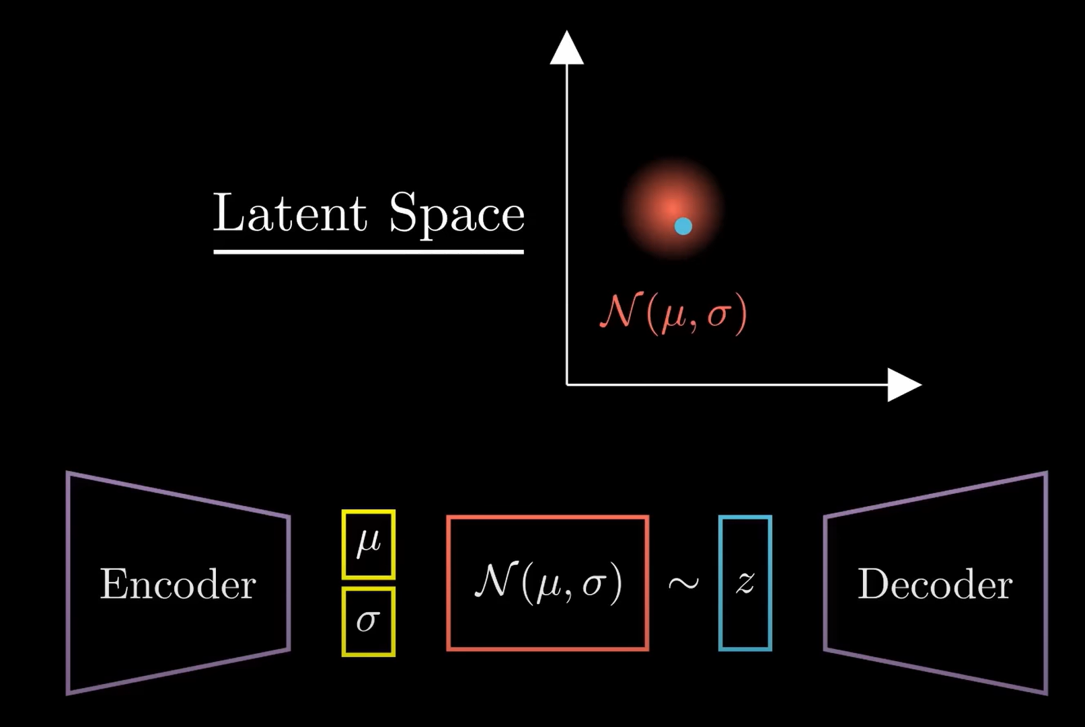

Slide 14
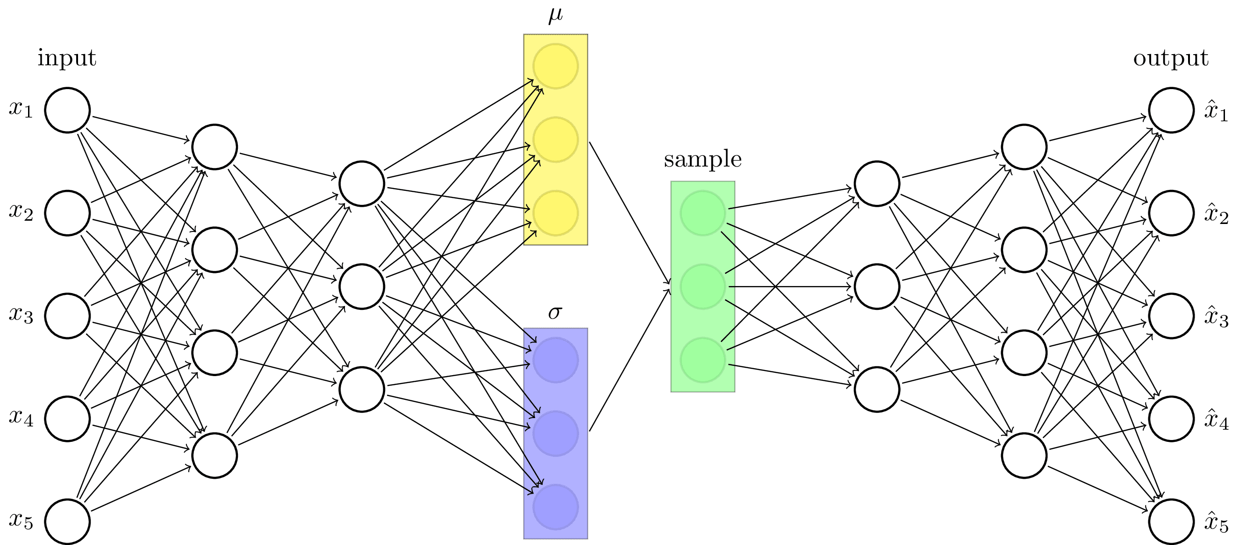
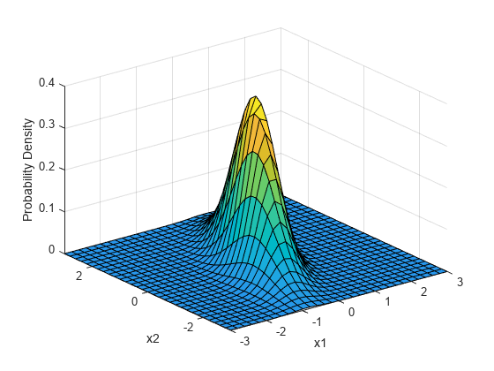
Variational autoencoder (VAE)
Machine Learning Methods for Biomedical Data (D012554)

Slide 15
VAE: applications
Dimensionality reduction: VAEs can compress high-dimensional biomedical data (e.g., gene expression, medical images) into a lower-dimensional latent space while preserving meaningful features.
Denoising & data imputation: VAEs can reconstruct missing or corrupted biomedical data, improving the quality of noisy datasets like MRI scans, ECG signals, or gene expression profiles.
Anomaly detection: By learning normal data distributions, VAEs can identify anomalies in biomedical datasets, aiding in early disease detection (e.g., identifying tumors in medical imaging).
Data privacy: VAEs can be used for privacy-preserving data sharing by generating synthetic patient data that retain statistical properties without exposing real patient records.
Gómez-Bombarelli et al. ACS Central Science (2019)
Machine Learning Methods for Biomedical Data (D012554)

Slide 16
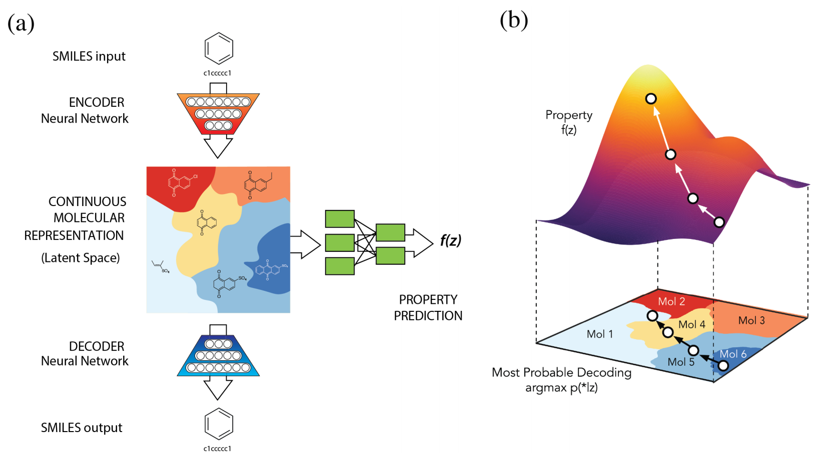
VAE: drug discovery
Representing chemicals in latent space to search for chemicals that optimize some function (e.g. maximize activity or minimize toxicity).
Gómez-Bombarelli et al. ACS Central Science (2019)
Machine Learning Methods for Biomedical Data (D012554)

Slide 17
Generative adversarial network (GAN)
A VAE learns a probabilistic distribution of the input data in a lower-dimensional latent space, rather than mapping inputs to fixed points like traditional autoencoders.
GANs generate sharper, more detailed images than VAEs, which often produce blurry results due to probabilistic constraints.
GANs do not impose a Gaussian prior, allowing for richer and more diverse data generation compared to VAEs.
GANs excel in generating high-quality synthetic biomedical images and unsupervised feature learning, whereas VAEs are better for structured latent representations and anomaly detection.
Machine Learning Methods for Biomedical Data (D012554)

Slide 18
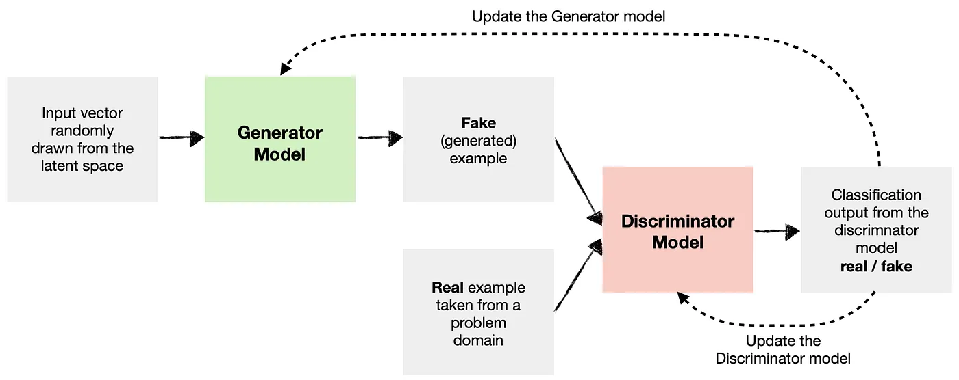
Generative adversarial network (GAN)
The generator CNN learns to generate new data (i.e., fake data) like that of the problem domain.
The discriminator CNN learns to identify whether the provided example is fake (comes from a generator ) or real (comes from the actual data domain).
Both the generator and the discriminator are trained together by minimizing one loss function.
.
Machine Learning Methods for Biomedical Data (D012554)

Slide 19
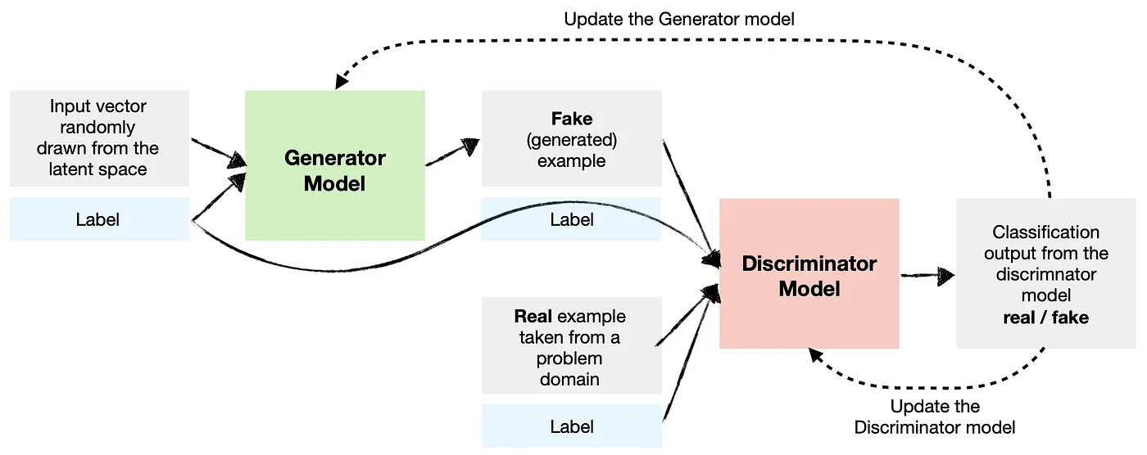
Conditional GAN (cGAN)
A cGAN extends standard GANs by incorporating extra input (e.g., class labels, text descriptions, or images) to guide the generation process, ensuring more controlled outputs.
The generator takes both random noise and a conditioning variable to produce relevant outputs, while the discriminator evaluates whether the generated sample matches the conditioning input.
Machine Learning Methods for Biomedical Data (D012554)

Slide 20
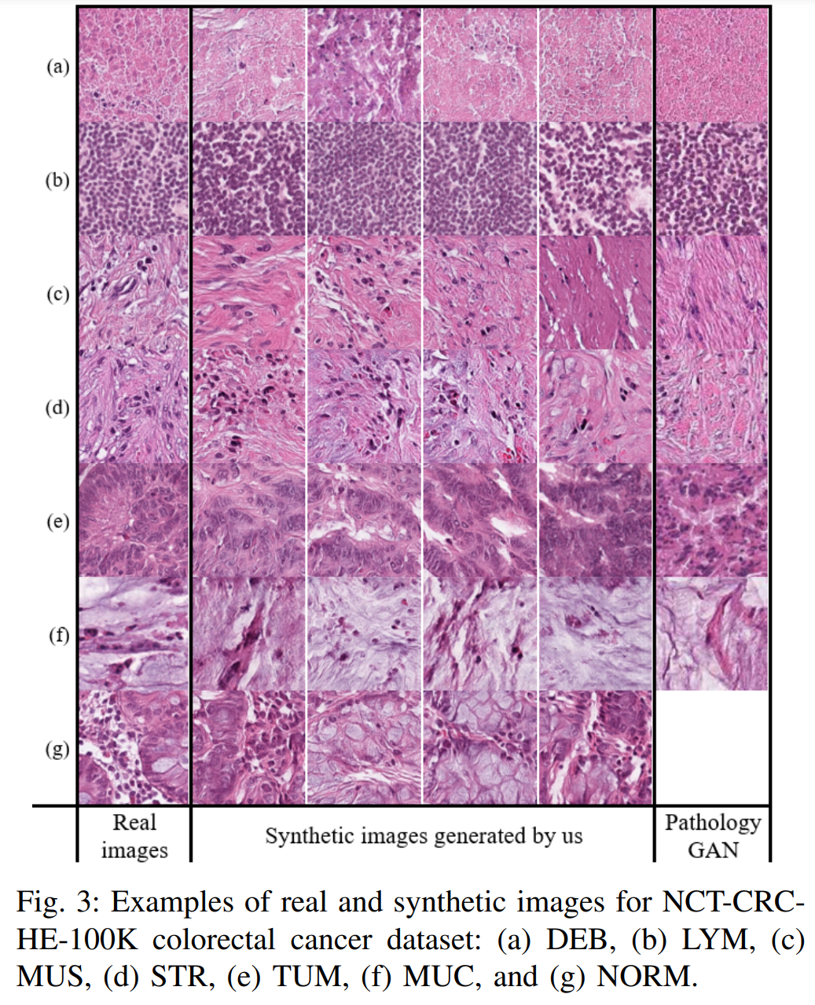
Conditional GAN (cGAN)
Conditioning allows the GAN to generate medical images that match specific disease conditions, patient attributes, or imaging modalities, ensuring the synthetic data is medically meaningful rather than random.
Machine Learning Methods for Biomedical Data (D012554)

Slide 21
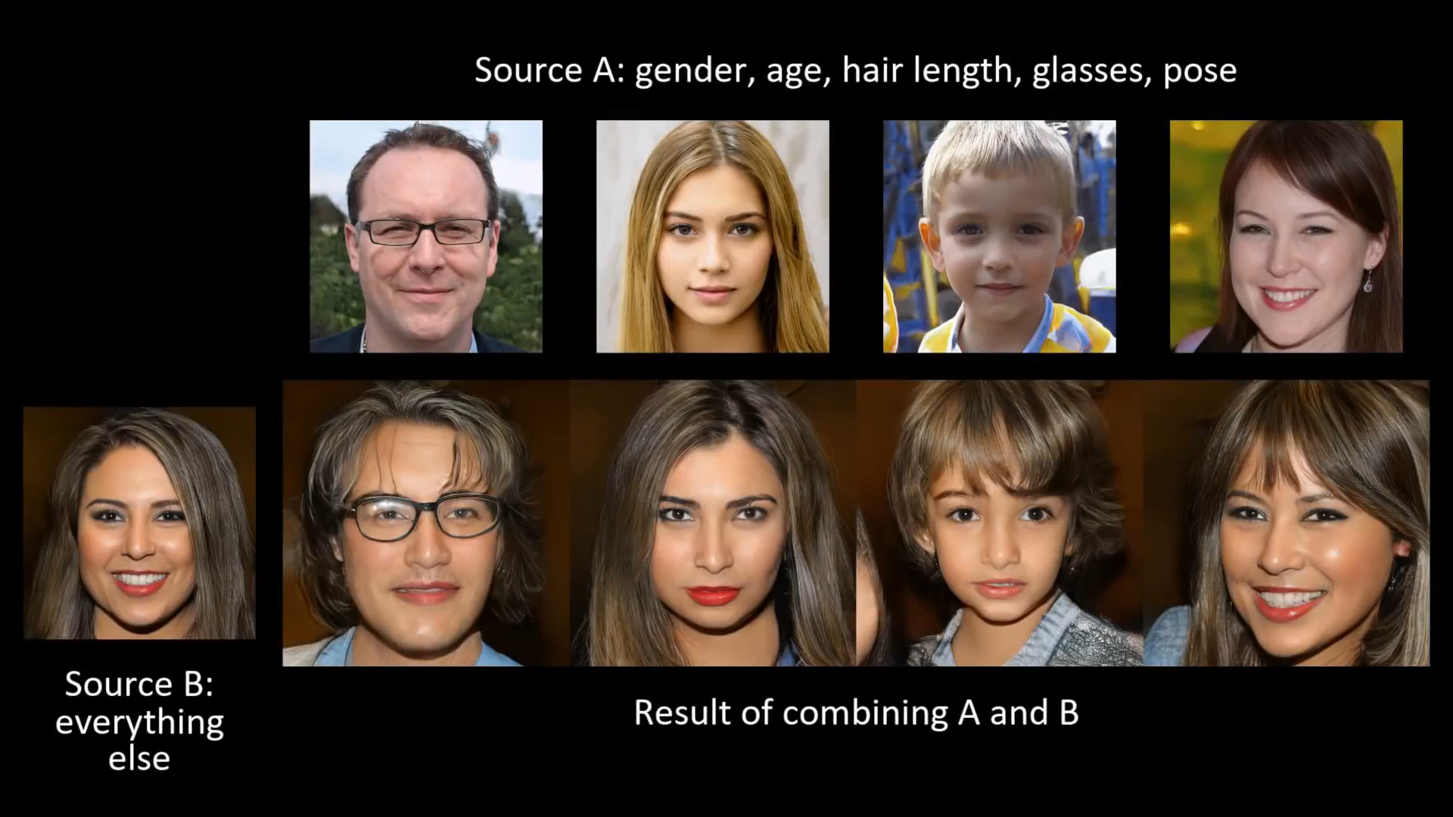

Slide 22
Diffusion model
Diffusion models generate data by gradually transforming pure noise into structured outputs through a series of small, incremental denoising steps.
They leverage a probabilistic model that learns the underlying data distribution by reversing the forward process of adding noise.
By refining details over multiple iterations, diffusion models can produce highly detailed and realistic images.
Their training strategy focuses on learning to denoise, which often results in stable and reliable convergence during the learning process.
Machine Learning Methods for Biomedical Data (D012554)

Slide 23
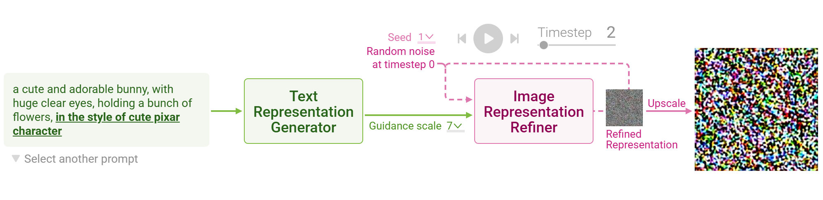
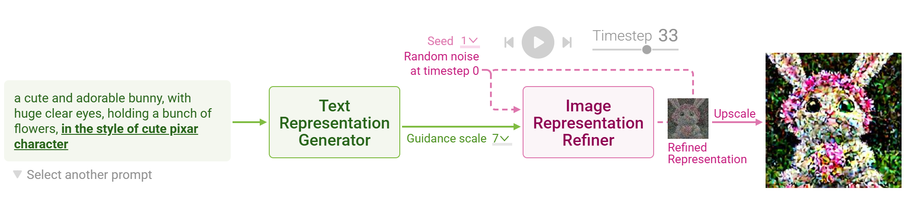
Diffusion model
The process involves a Text Representation Generator that converts the input prompt into an initial representation, followed by an Image Representation Refiner that enhances the image over multiple steps using noise reduction and a guidance scale.
https://poloclub.github.io/diffusion-explainer/
Machine Learning Methods for Biomedical Data (D012554)

Slide 24
Diffusion model
The process involves a Text Representation Generator that converts the input prompt into an initial representation, followed by an Image Representation Refiner that enhances the image over multiple steps using noise reduction and a guidance scale.
https://poloclub.github.io/diffusion-explainer/
Machine Learning Methods for Biomedical Data (D012554)

Slide 25
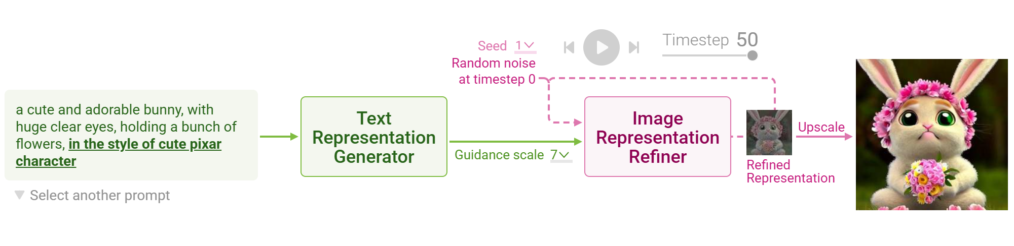
Diffusion model
The process involves a Text Representation Generator that converts the input prompt into an initial representation, followed by an Image Representation Refiner that enhances the image over multiple steps using noise reduction and a guidance scale.
https://poloclub.github.io/diffusion-explainer/
Machine Learning Methods for Biomedical Data (D012554)

Slide 26
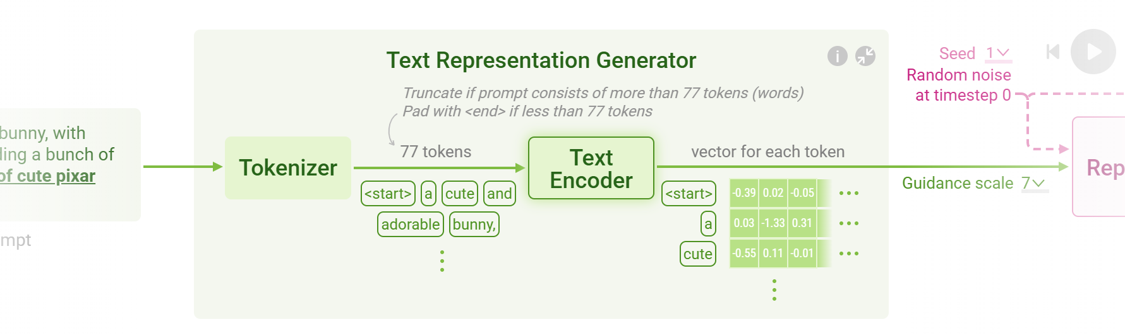
Diffusion model
The Text Encoder converts each token into a numerical representation (embedding).
Each word is mapped to a high-dimensional vector, as shown in the matrix with numerical values for words like "cute" and "bunny.“
The generated token vectors are fed into the Image Representation Refiner (next stage), which uses them to guide the creation of an image.
https://poloclub.github.io/diffusion-explainer/
Machine Learning Methods for Biomedical Data (D012554)

Slide 27
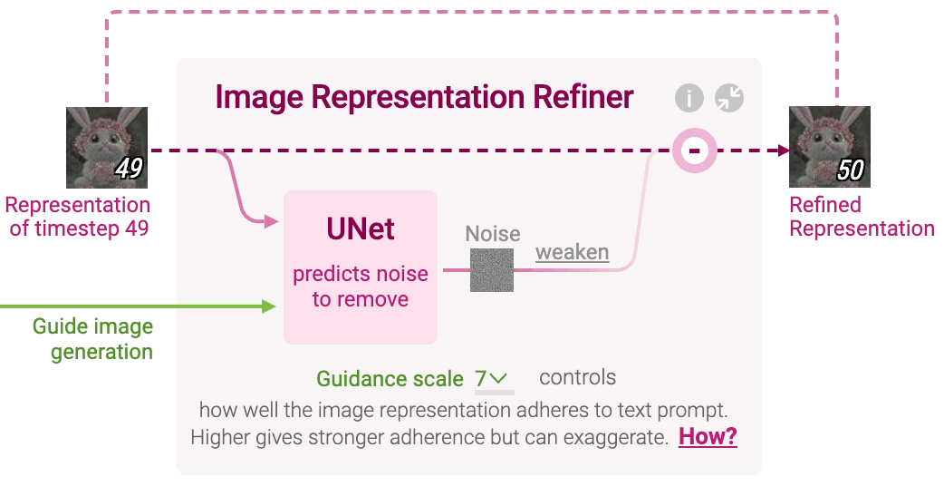
Diffusion model
The Image Representation Refiner uses a U-Net model to predict and remove noise from an intermediate image. This process gradually improves the image quality by iteratively reducing noise.
https://poloclub.github.io/diffusion-explainer/
Machine Learning Methods for Biomedical Data (D012554)

Slide 28
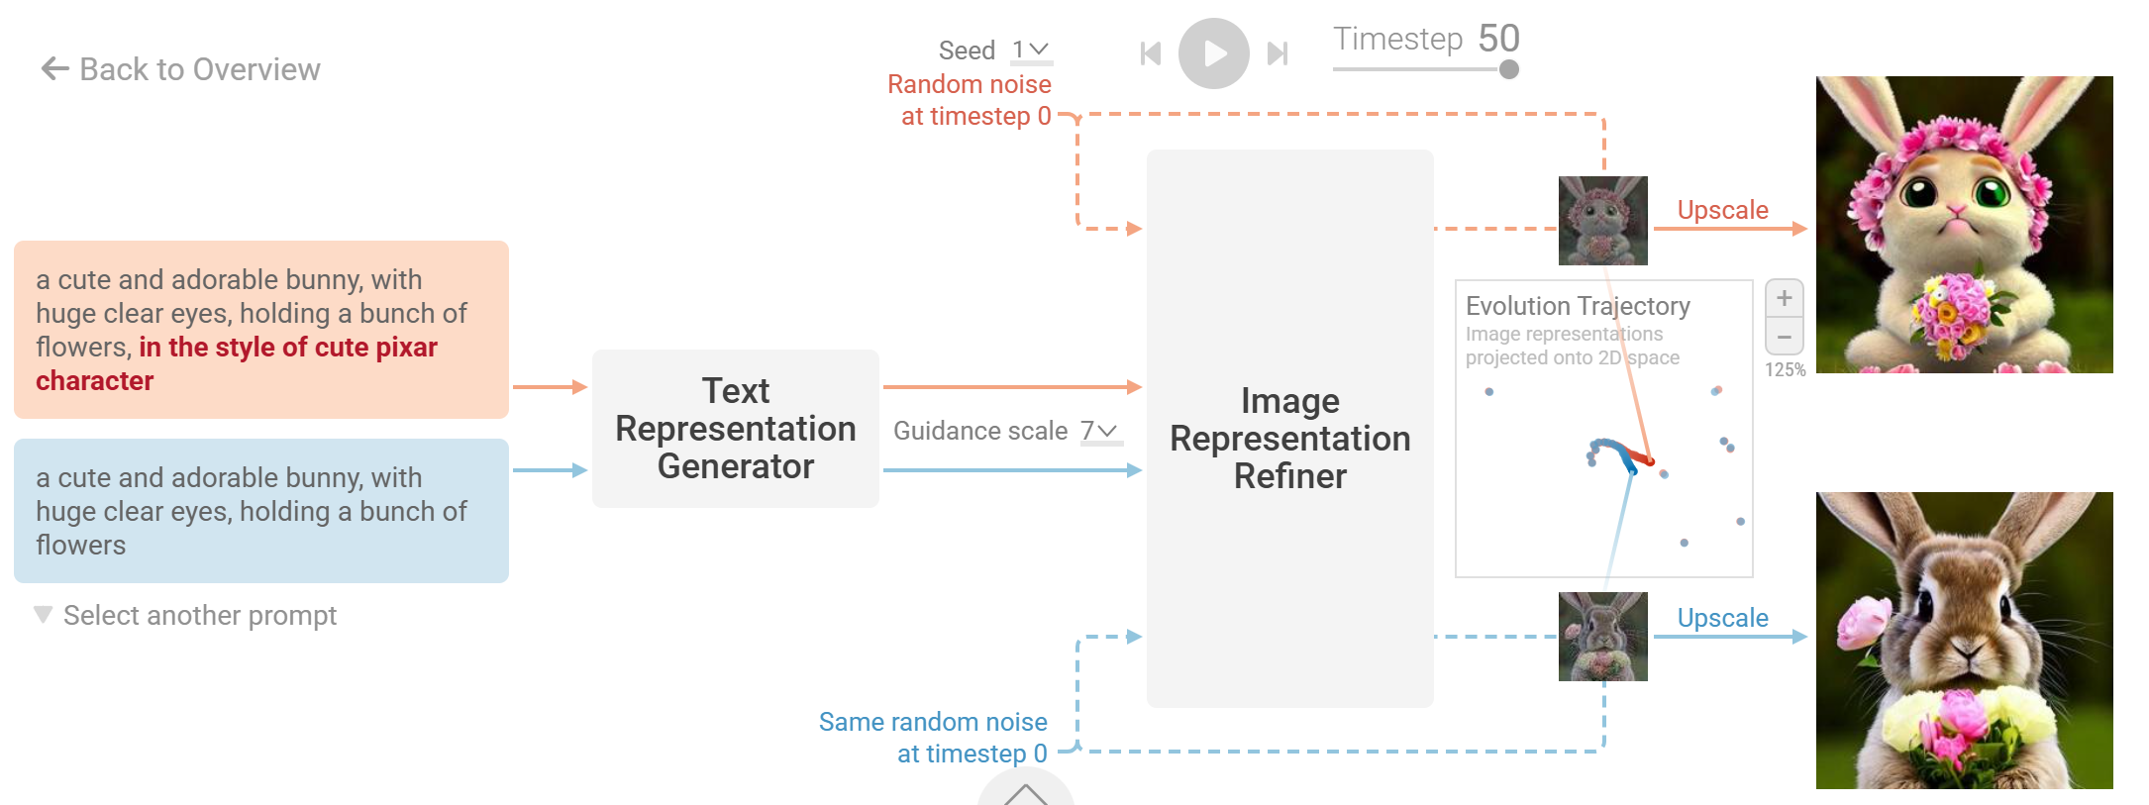
Contrastive Language-Image Pretraining (CLIP)
CLIP helps diffusion models understand how well an image matches a given text prompt by embedding both text and images into a shared feature space.
The diffusion model uses this guidance to iteratively refine the image toward better alignment with the prompt.
https://poloclub.github.io/diffusion-explainer/
Machine Learning Methods for Biomedical Data (D012554)

Slide 29
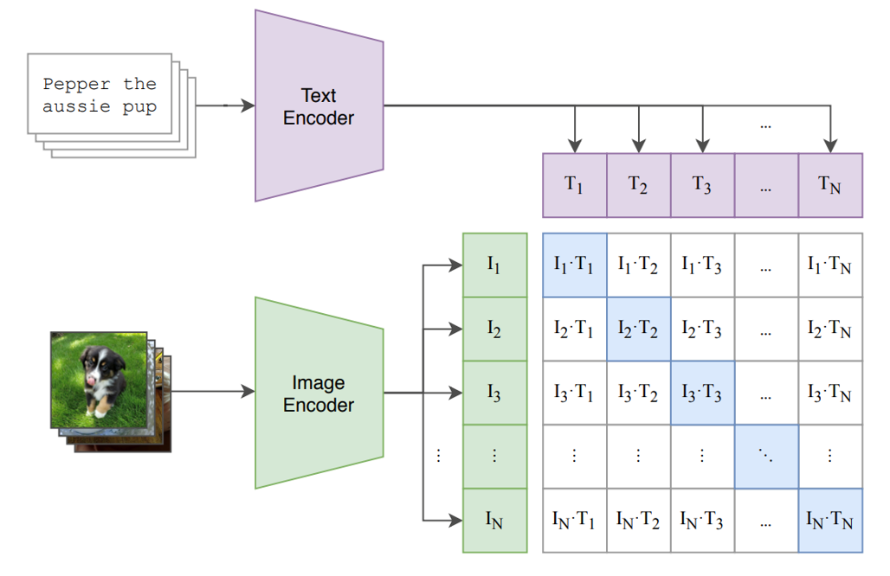
Contrastive Language-Image Pretraining (CLIP)
CLIP is trained on a large dataset of image-text pairs to learn a shared embedding space, where both images and textual descriptions are represented as vectors in that same space.
It uses a contrastive loss that aligns the embeddings of matching image-text pairs while pushing non-matching pairs apart, effectively capturing semantic relationships.
Radford, A. et al. (2021). Learning Transferable Visual Models From Natural Language Supervision, ICML, PMLR 139, 8748–8763
Machine Learning Methods for Biomedical Data (D012554)

Slide 30
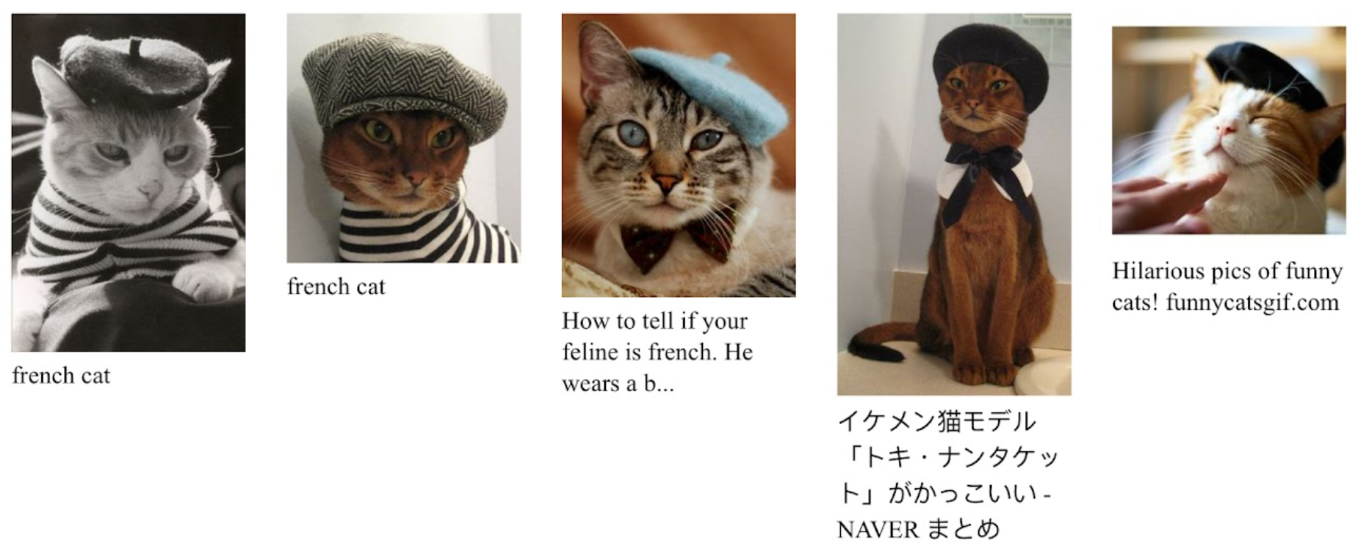
Data: LAION datasets
LAION-400M comprises about 400 million image–text pairs, while LAION-5B scales up to roughly 5 billion pairs, making them some of the largest open datasets for text-to-image tasks.
Both datasets are sourced from extensive web crawls, ensuring a wide variety of visual content and textual descriptions across numerous domains and topics.
These datasets feature a diverse range of languages—with approximately 50% of the pairs in English and the remainder spanning over 80 other languages—facilitating the training of globally applicable models.
Schuhmann, C., et al. (2021). LAION-400M: Open Dataset of 400 Million Image-Text Pairs. Zenodo. doi:10.5281/zenodo.3779943
Machine Learning Methods for Biomedical Data (D012554)

Slide 31
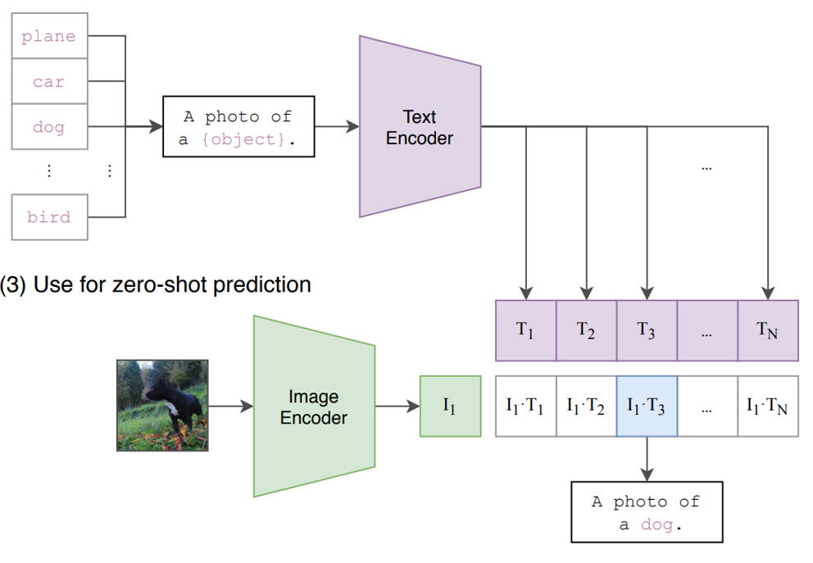
Zero-shot image classification with CLIP
CLIP learns a shared representation for images and text by training on large amounts of image–text pairs, enabling it to match an unseen image with relevant textual descriptions without explicit training on specific categories.
By comparing an image’s embedding to embeddings of class labels or prompts, CLIP can identify the most semantically similar label, allowing it to classify images into new categories it was never directly trained on.
Radford, A. et al. (2021). Learning Transferable Visual Models From Natural Language Supervision, ICML, PMLR 139, 8748–8763
Machine Learning Methods for Biomedical Data (D012554)

Slide 32
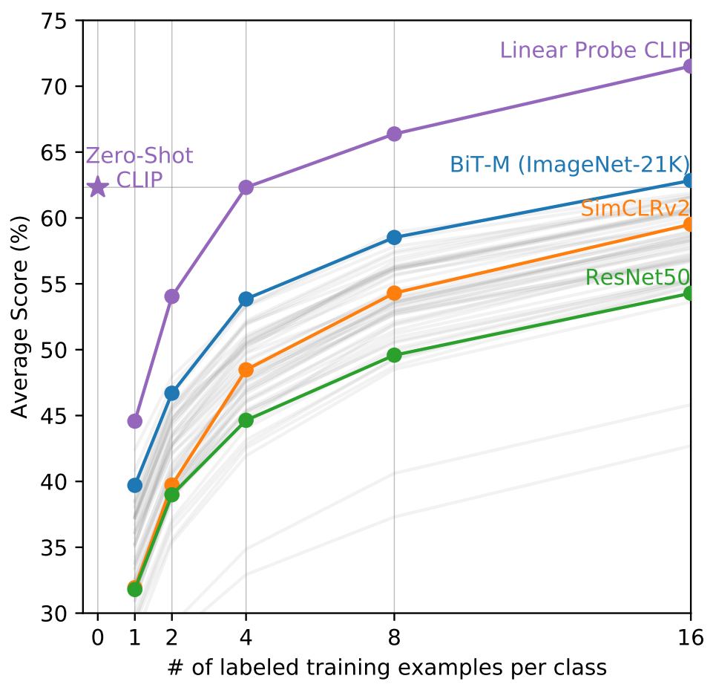
Zero-shot image classification with CLIP
CLIP learns a shared representation for images and text by training on large amounts of image–text pairs, enabling it to match an unseen image with relevant textual descriptions without explicit training on specific categories.
By comparing an image’s embedding to embeddings of class labels or prompts, CLIP can identify the most semantically similar label, allowing it to classify images into new categories it was never directly trained on.
Radford, A. et al. (2021). Learning Transferable Visual Models From Natural Language Supervision, ICML, PMLR 139, 8748–8763
Machine Learning Methods for Biomedical Data (D012554)

Slide 33

Zero-shot image classification with CLIP
CLIP_image_classification.ipynb
Machine Learning Methods for Biomedical Data (D012554)

Slide 34
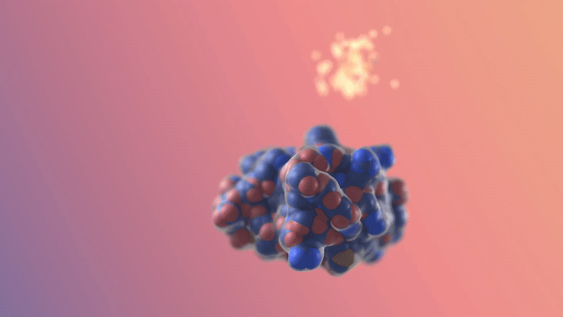
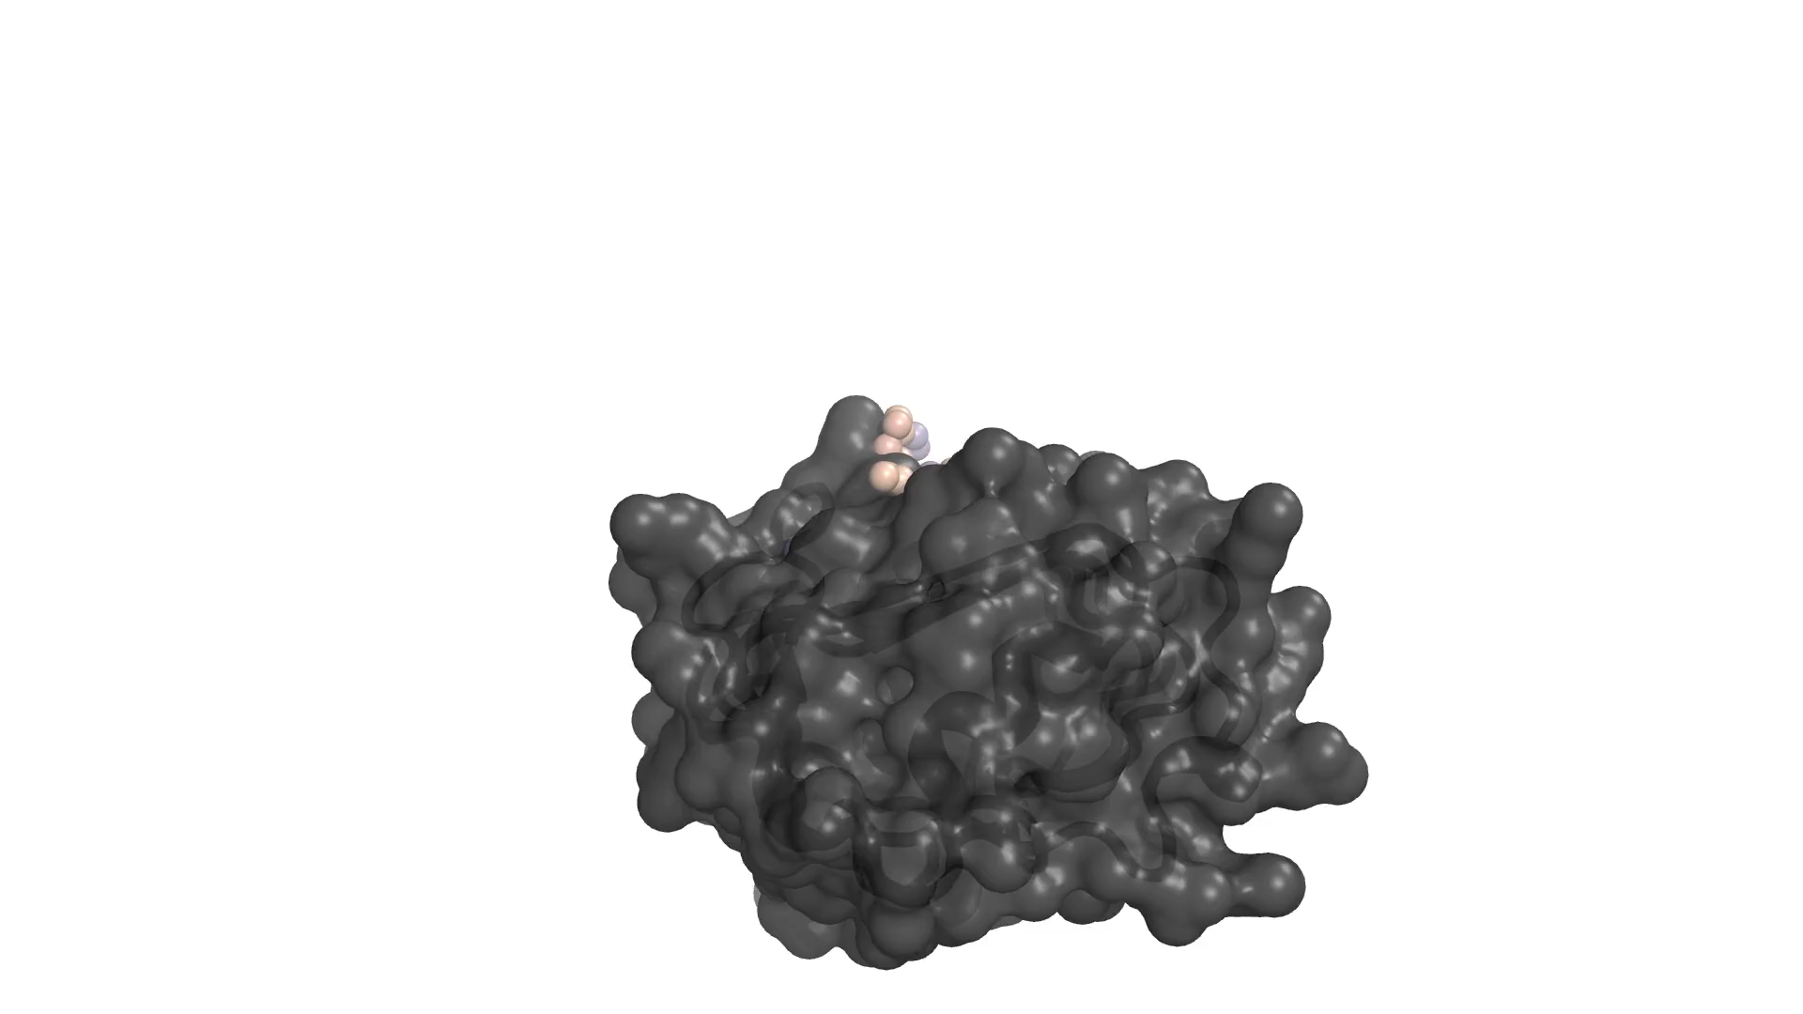
Diffusion models: RFdiffusion
RFdiffusion begins with random noise and progressively refines it through a reverse diffusion process to form coherent protein structures.
It integrates structural priors from pre-trained ensuring generated conformations adhere to realistic protein geometry.
The process is conditioned on specific design objectives—like binding sites or active motifs—to tailor the protein output to functional requirements.
By combining diffusion-based refinement with learned protein structure knowledge, RFdiffusion enables the generation of novel, physically plausible protein designs.
Watson, J.L., et al. (2023). De novo design of protein structure and function with RFdiffusion. Nature, 620, 687–694.
Machine Learning Methods for Biomedical Data (D012554)

Slide 35
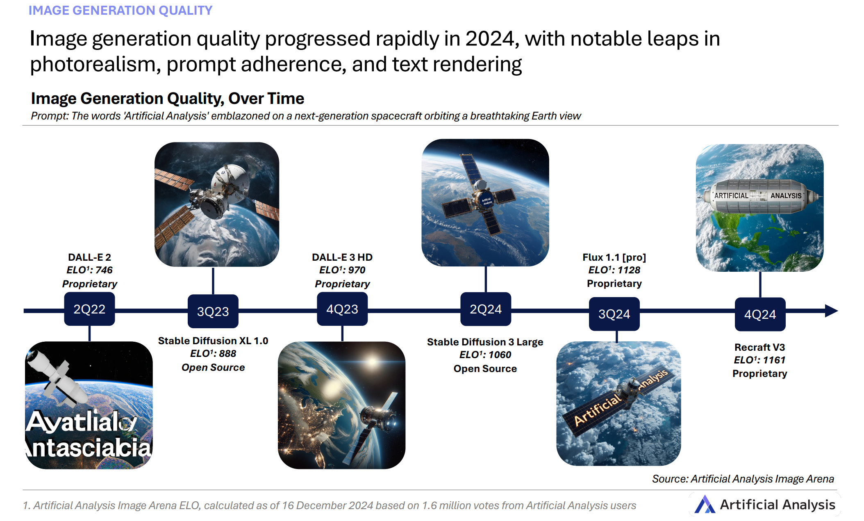
Machine Learning Methods for Biomedical Data (D012554)

Slide 36
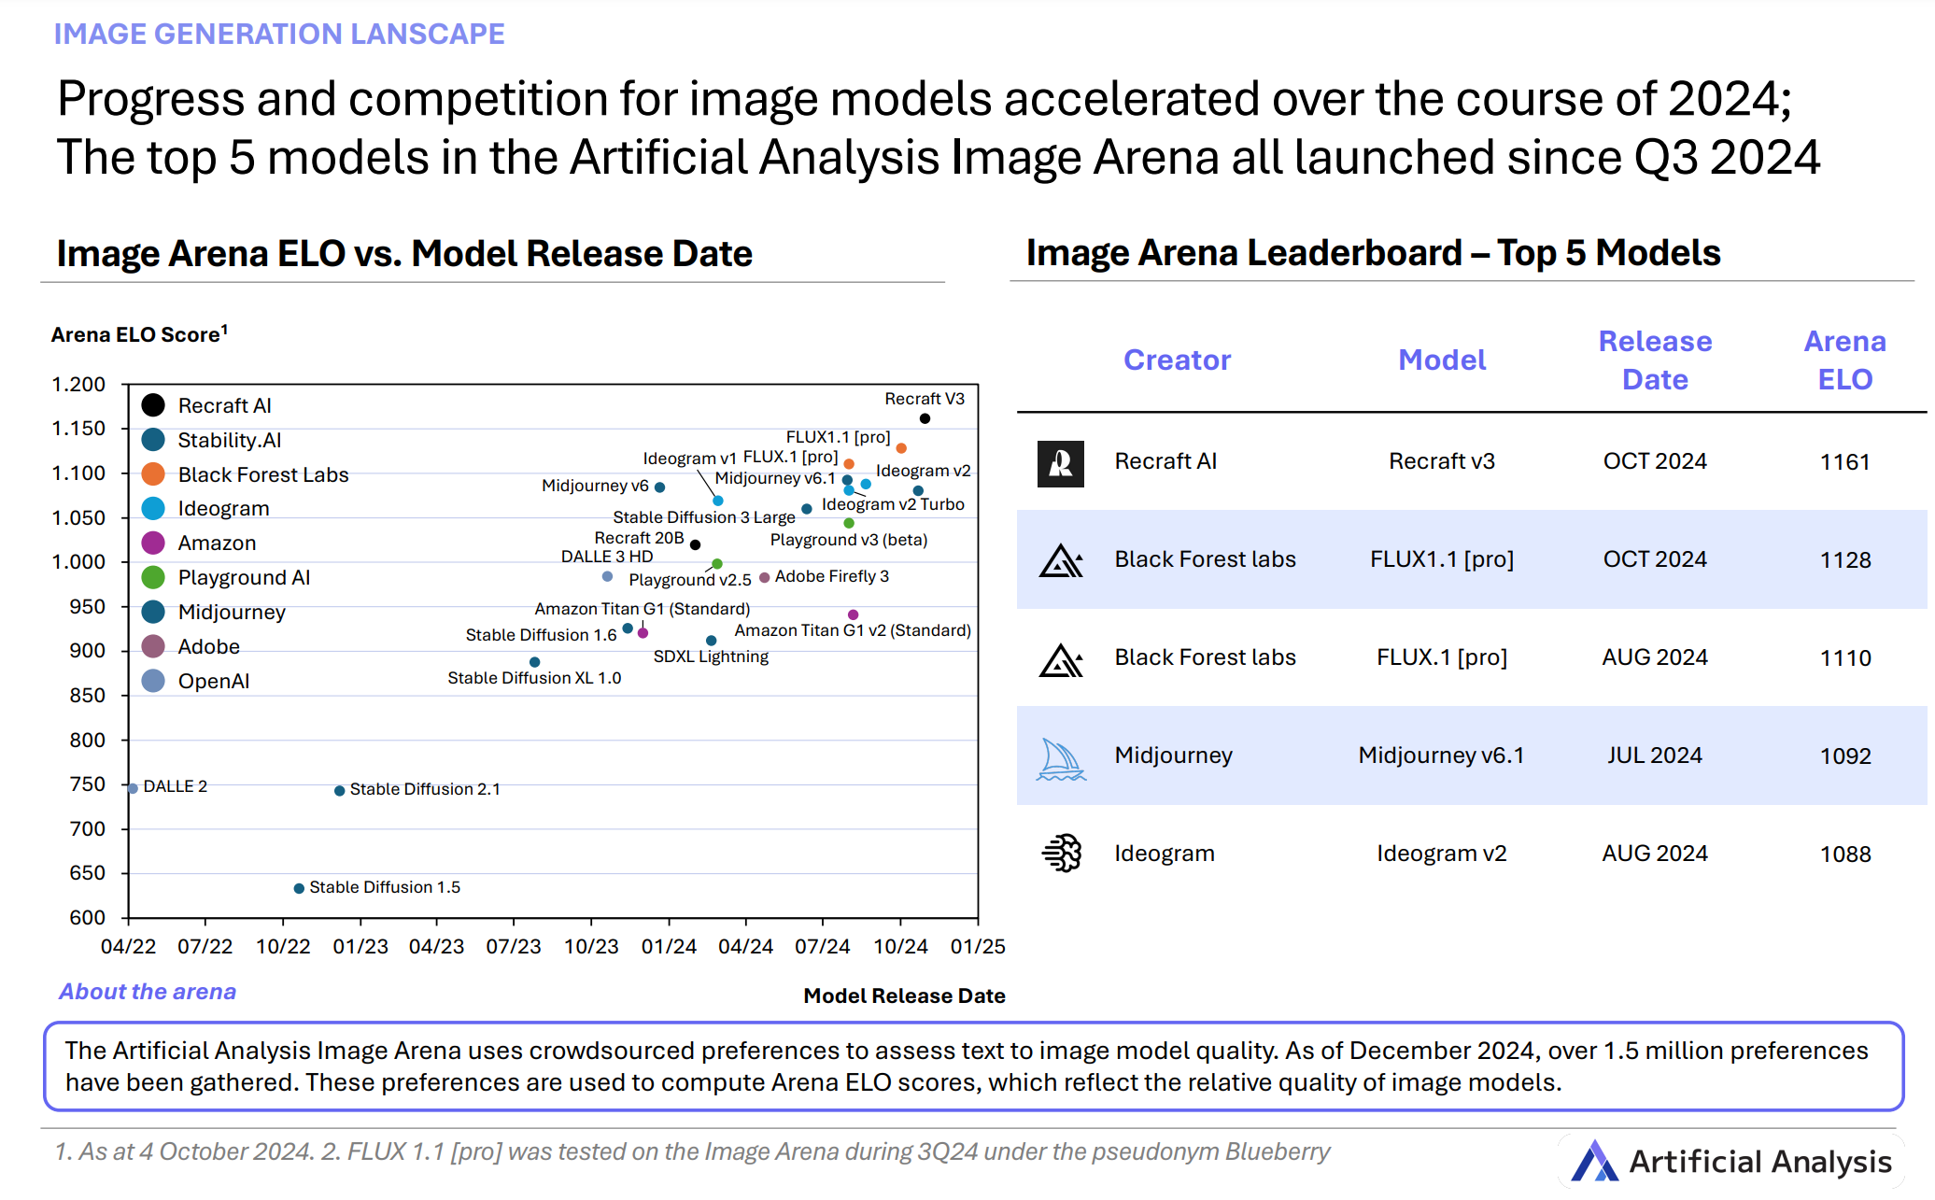
Machine Learning Methods for Biomedical Data (D012554)

